Slide 1
AVIATION ACCIDENTS IN UNITED STATES

Slide 2
BACK-GROUND
One of the means of the transport is by air. In United States , it experience number of accidents in aviation sector every year. Safety of aircrafts, pilot and other users is paramount. We will figure out the causes and factors that contribute these accidents.

Slide 3
PROBLEM STATEMENT
Considering the number of accidents in aviation sector notwithstanding the modern aircraft in United States is an alarming. Hence is necessary to find out the causes and make recommendation for future safety improvement.

Slide 4
Project Goals
To analyze the trend of the accidents for the last years
To find out the states which the accidents occurs mostly
To examine the kind of aircrafts which are associated with accident mostly
To provide recommendation based on the findings

Slide 5
DATA
The data set used for this analysis was downloaded from Kaggle website. The NTSB database recorded the accidents and incidents from 1942 to 2023.

Slide 6
METHODS
Python Language
Pandas Library
Numpy Library
Matplotlib library
Seaborn Library
Tableau
IDE USED
VISUAL STUDIO
Jupyter Notebook
Google Colab

Slide 7
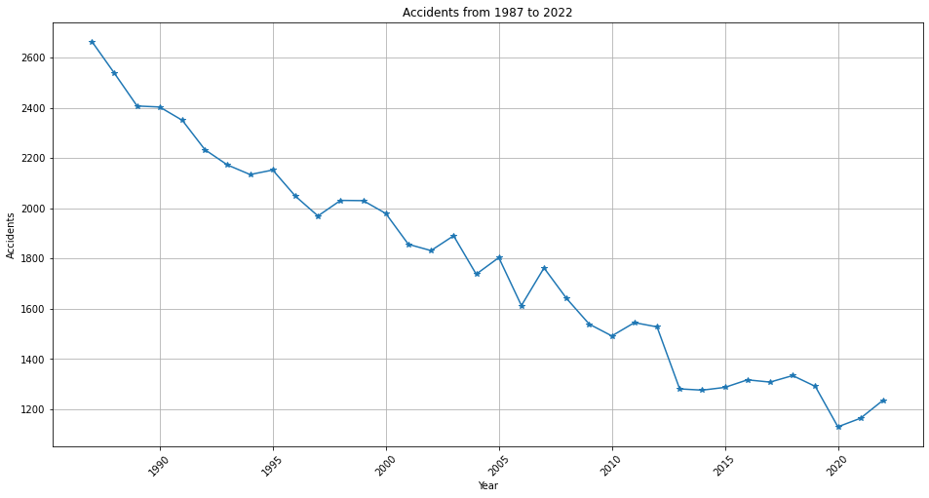
ACCIDENTS AND TRENDS
On the line plot, it shows decreasing of accidents from 1987 to 2022. it indicate an improvement in aviation sector.

Slide 8
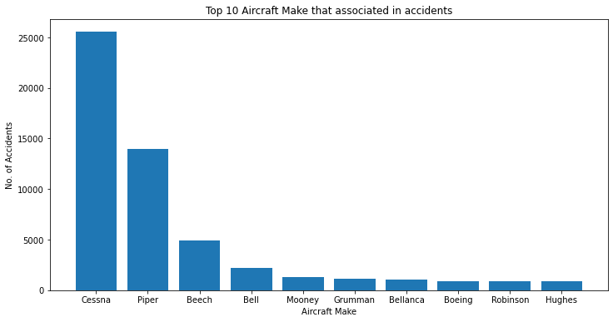
TOP 10 AIRCRAFTS MAKE THAT ARE ASSOCIATED WITH ACCIDENTS
On the bar graph, Cessna Aircraft are mostly involved an accident. Piper and Beech aircrafts also have significant scenarios of accidents.

Slide 9
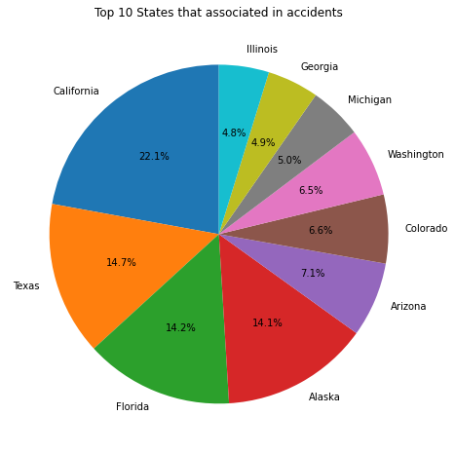
TOP 10 STATES THAT ARE ASSOCIATED WITH ACCIDENTS
The pie chart shows California, Texas ,Florida and Alaska have the highest number of accidents.

Slide 10
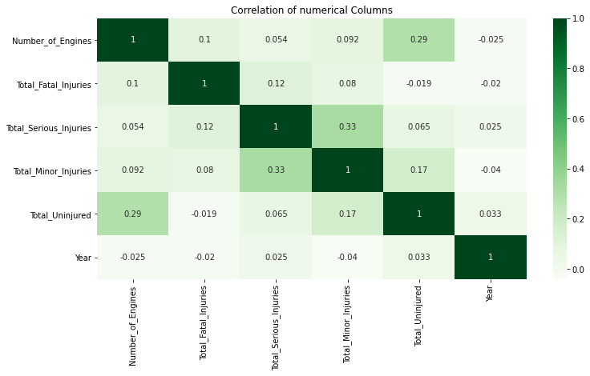
Correlation among numerical values
The result is largely negative thus weak correction among them

Slide 11
RESULTS
California, Texas ,Florida and Alaska have the highest number of accidents.
Cessna Aircraft are mostly involved an accident. Piper and Beech aircrafts also have significant scenarios of accidents.
The accidents has declined from 1987 to 2022

Slide 12
Next step
Analyze the causes of accidents in top 10 states

Slide 13
RECOMMENDATIONS AND CONCLUSIONS
1. Maintenance .
For all aircrafts should be maintained regularly.Bofore the departure must be checked and approved by aviation department for the safety of the aircrafts, pilot and other users.
2. Suspension of high risk aircrafts .
The Cessna , Piper and Beech aircrafts must be suspended with the immediate effect. Generally those aircrafts have mechanical problem .Also introduce a periodic inspection of the aircrafts. The regulatory body should approved if their safe for transport. Thus gaining confidence from the users.

Slide 14
RECOMMENDATIONS AND CONCLUSIONS CONT……
3. Improving safety of high risk states .
California ,Texas , Florida and Alaska should be investigated the high cause of accidents. Some factors could be contributed like Weather condition , human error and possibly mechanical problem regarding the aircrafts. This will enhance aviation safety .
4. Technologies .
Airlines company should adopt the modern technology aircraft which enhance safety and reduce the accidents caused by older models. This will signal out any slight mechanical failure hence increased efficiency.
5. Training.
Human error contribute majorly to the occurance of accidents. The aviation should provide safety training program for pilots

